Slide 1
AdaNet for Concrete Strength prediction

Slide 2
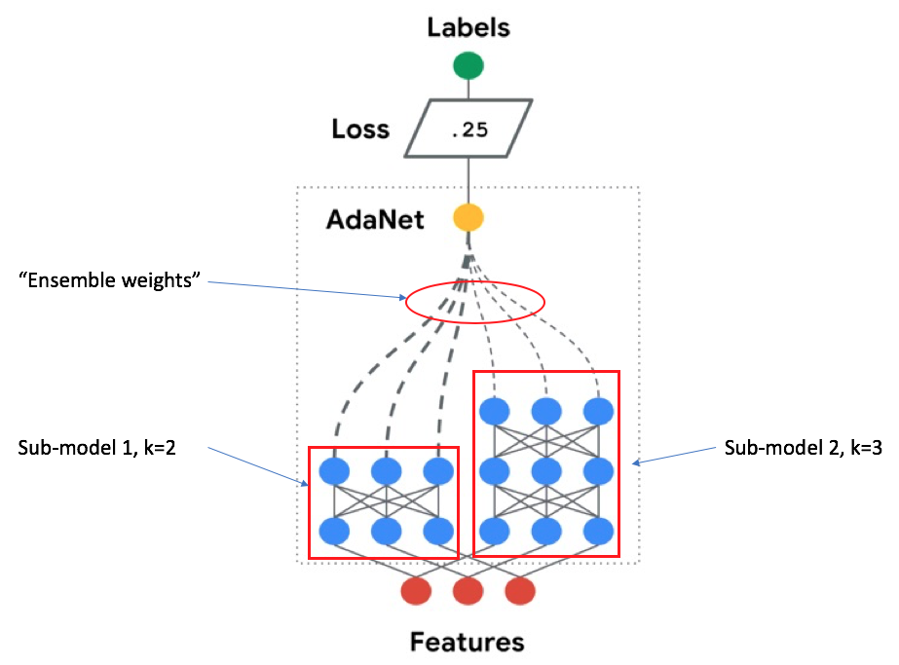
Adaptive Structural Learning (AdaNet)
Ensemble of several subnetworks
Include a candidate subnetwork only when it improves the ensemble’s training loss
https://ai.googleblog.com/2018/10/introducing-adanet-fast-and-flexible.html

Slide 3
AdaNet
Generating subnetworks
Grouping strategy
Combining each group of subnetworks (ensembles)
The best ensemble moves onto the next iteration
Evaluating loss of ensembles

Slide 4
AdaNet
Current Model:
Comparing two subnetworks at each iteration
One of the subnetworks has one additional hidden layer
The number of hidden layer starts from zero

Slide 5
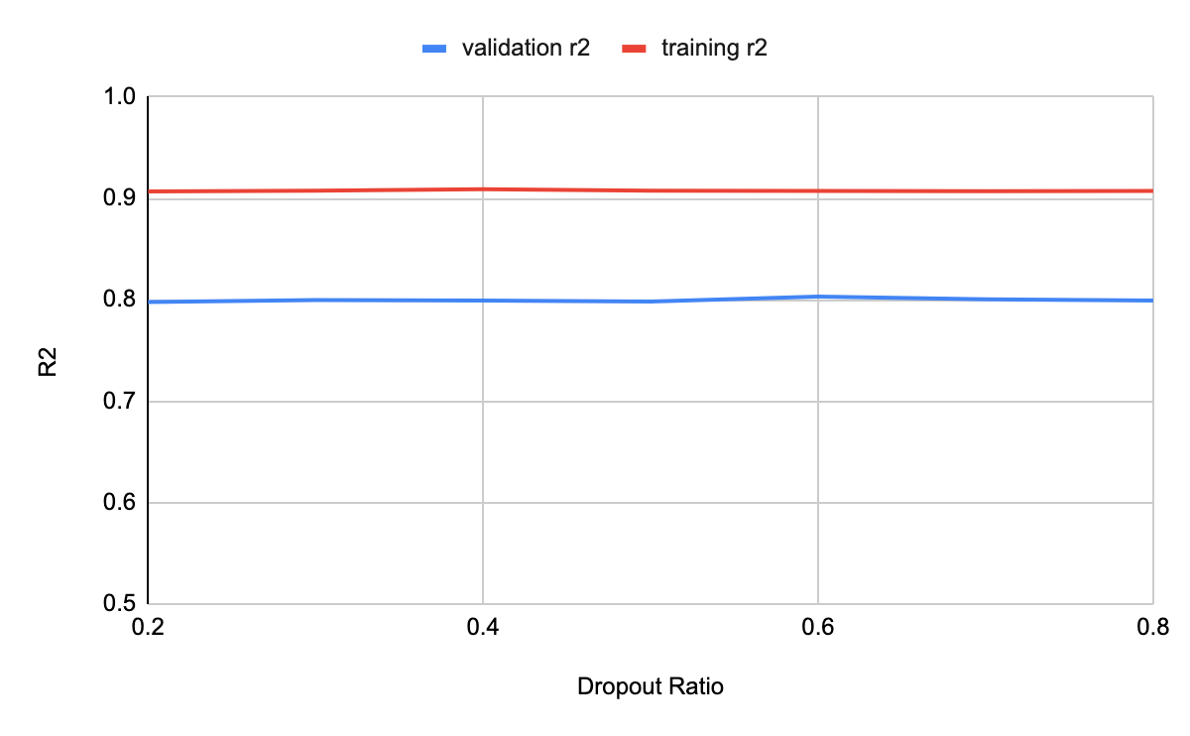
AdaNet
lambda | 0.005
beta | 0.04
step | 3000
start # | 1
iteration | 5
optimizer | Adam
dropout ratio | validation r2 | training r2
0.2 | 0.7977 | 0.9069
0.3 | 0.7997 | 0.9076
0.4 | 0.7992 | 0.909
0.5 | 0.7983 | 0.9077
0.6 | 0.8033 | 0.9074
0.7 | 0.80043 | 0.9071
0.8 | 0.7992 | 0.9075

Slide 6
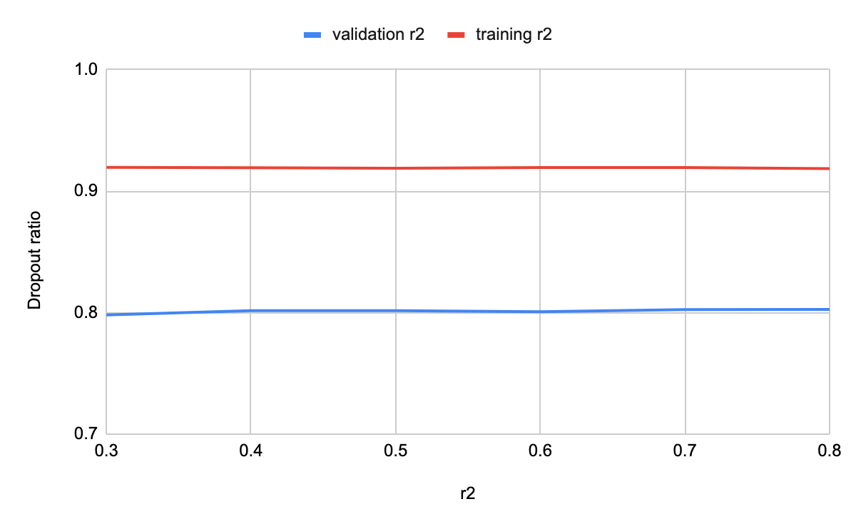
AdaNet
lambda | 0.005
beta | 0.04
step | 3000
start # | 5
iteration | 5
optimizer | Adam
dropout ratio | validation r2 | training r2
0.2 | 0.7981 | 0.9197
0.3 | 0.8017 | 0.9193
0.4 | 0.8017 | 0.9189
0.5 | 0.8007 | 0.9195
0.6 | 0.8025 | 0.9195
0.7 | 0.8026 | 0.9186
0.8 | 0.8051 | 0.9209

Slide 7
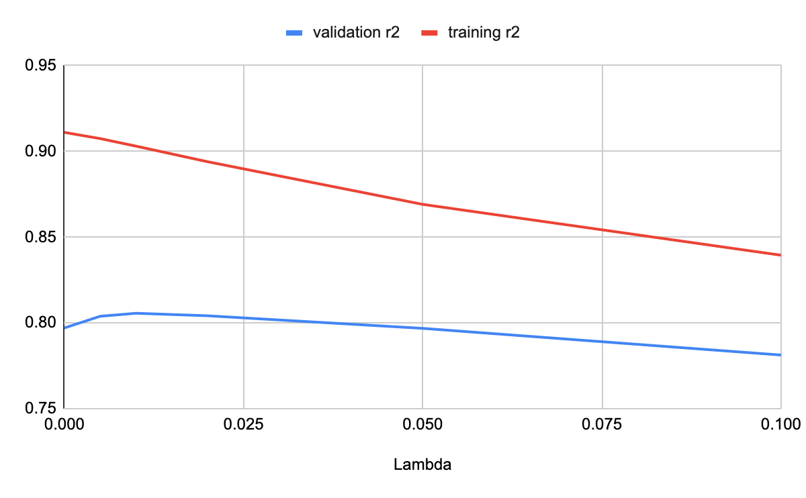
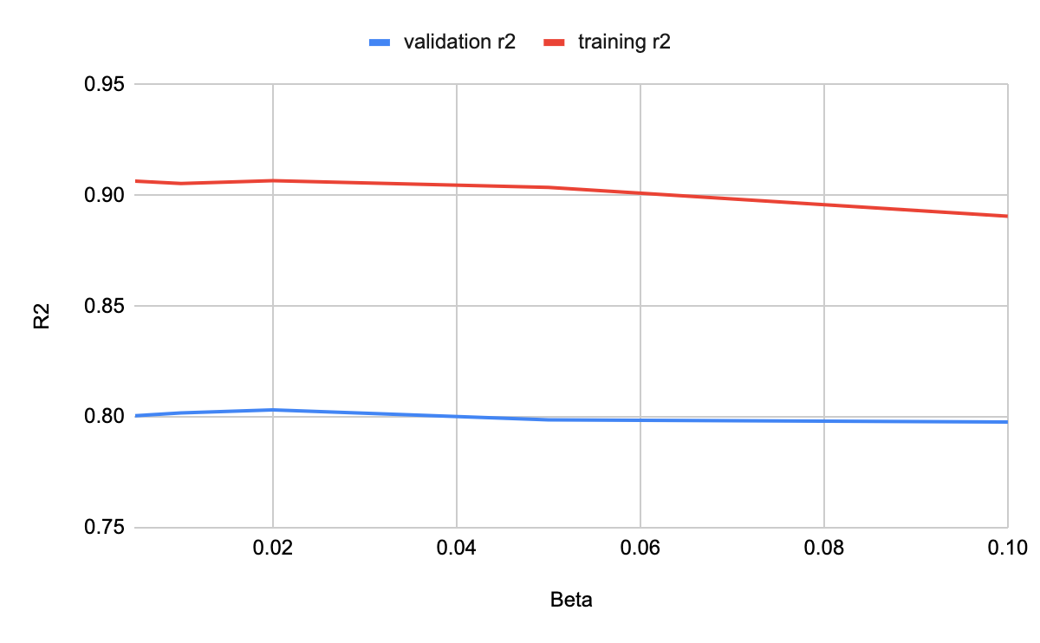
RMSProp as Optimizer

Slide 8
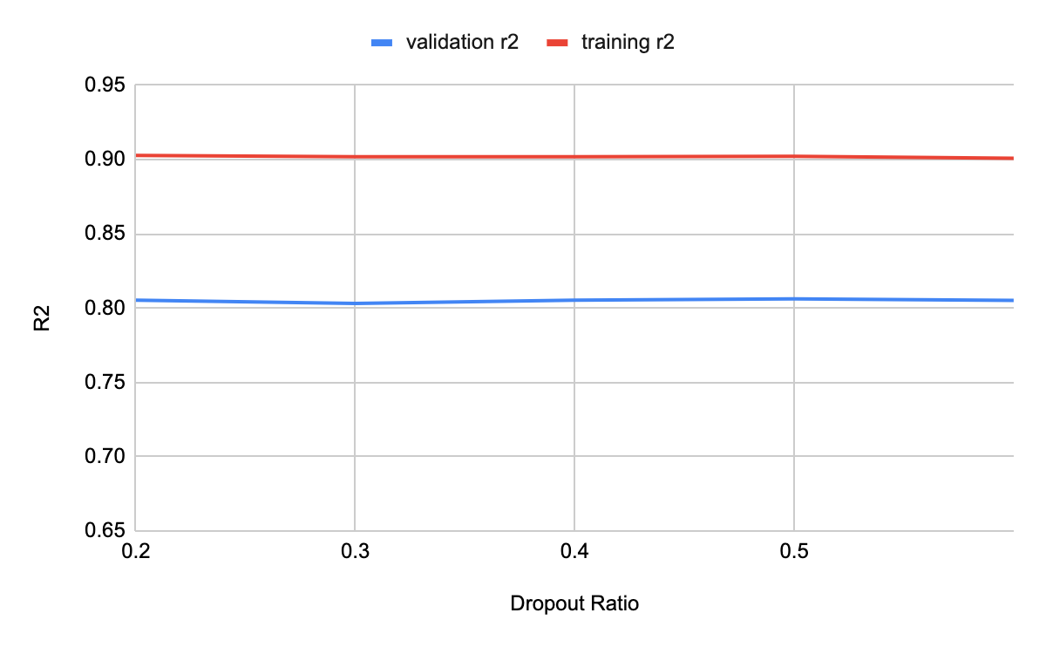
AdaNet
lambda | 0.005
beta | 0.04
step | 3000
start # | 5
iteration | 5
optimizer | RMSProp
dropout ratio | validation r2 | training r2
0.2 | 0.8054 | 0.9028
0.3 | 0.8031 | 0.9019
0.4 | 0.8054 | 0.9019
0.5 | 0.8062 | 0.9022
0.6 | 0.8052 | 0.9009
0.7 | 0.8047 | 0.9011
0.8 | 0.8054 | 0.9017

